Slide 1
REST API Caching
Caching architectural constraints
HTTP cache control headers

Slide 2
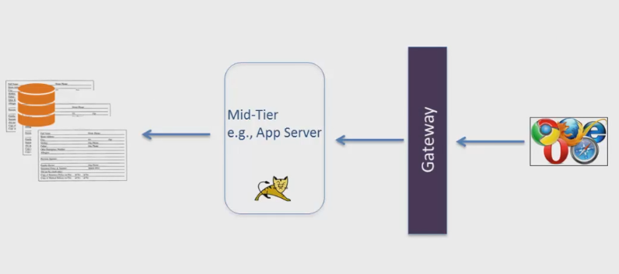
Typical Web Caching
Shared Cache
Shared Cache
Local Cache
Notes:
--- lets take a look at how caching is implemented on a typical web site
--- (CLICK) the browser maintains a local cache
--- so the responses coming form the server to the browser gets written to a file system
---- upon the next call to the website the browser checks its’ local cache is see if it already has the page or information that you request
--- the goal is for the system to use the cache response on your local file system instead of going to the server to retrieve already cached data
---- (CLICK) a shared cache can be managed on a gateway server like a security gateway, there is normally a caching of security information on a security gateway so that the request won’t have to go back to the server to retrieve security information
--- (CLICK) another way to implement caching is on the mid-teir, either for the software or for the hardware.
----- the objective of Mid-Tier caching is to improve the scalability of the application and to enhance the user experience

Slide 3
What We’ll Cover Today
Statelessness
Negative impact on performance
Chattiness
Higher data traffic (impact’s scalability)
Caching
Performance
Scalability
Reduce chattiness
Notes:
---- we have already talked about the statelessness constraint of a REST API
----- we said that the session management, or the state management or the application management in the mid-teir is not acceptable from the REST API perspective
---- (CLICK) often stateless leads to a negative impact on performance
----- (CLICK) it may lead to Chattiness on the network; which means that you have an abundance of information traveling from the client to the server and from the server to the client
---- and also it will lead to (CLICK) Higher data traffic
----- remember that statelessness only works when the client send all the information needed to process the request
---- these are all the negative impacts of statelessness
----- Caching can offset some of the negativity of statelessness
----- with Caching (Click) you achieve higher performance; (CLICK) better scalability
------ (CLICK) and reduce chattiness
----- so Caching improves some of the performance of the Statelessness

Slide 4
HTTP Header Caching
Response Message
Cacheable
Non-cacheable
Important Headers for Caching
Cache-Control : Who, how long, under what conditions
Example: private; max-age=60
Expires – tell when the resource will expire
Last-Modified – tells when the resource was last changed
Etag – Unique identifier associated with a response
Carabineers
Gaiters
Caching is controlled by server
HTTP Headers
Notes:
---- (CLICK) the REST API architecture requires that the response message from the service be labeled as cacheable or non-cacheable
---- (CLICK) the caching is controlled by the server by way of HTTP headers
---- (CLICK) let high light a few of the important headers
-----(CLICK) Cache-Control – this header will allow the server to define the policy for the cache
---- [CLICK] – who can control the cache, how long will the cache last, Under what conditions the data will be cached
----- all of these are controlled by the Cache-Control header
------ (CLICK) an example is private; max-age=60 – what this says is that the data be cached only by a single client because the data is intended only for a single user; and the maximum age of the cache data is 60 seconds
----- [CLICK] Expires – tells when the resource or Cache will get expired
------ (CLICK) Last-Modified – the server tells the client when the resource was last changed, when was the last time this cache resource was modified
----- Etag Header – the Etag associates a unique identifier with a response, like an ID, or a unique

Slide 5
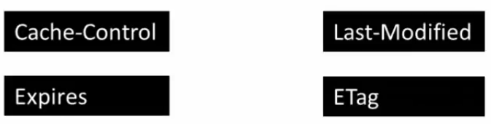
Summary
Cache
Counterbalance the statelessness
May occur on server, mid-tier, client or any accessible machine
Server
Mark a response as cacheable or non-cacheable
HTTP headers and caching policies
Notes:
----- (CLICK) Cache is used to counter-balance the statelessness as well as reduce network chattiness
------ (CLICK) Cache may occur on server, mid-tier, client, gateway, the application server or any machine accessible by the response/request
------- (CLICK) The server has to mark a response as cacheable, or non-cacheable
------ (CLICK) The server can also attach caching policies by way of HTTP headers
+++++ (CLICK) such as cache-control, expires, last-modified, ETAG

Slide 6

Quiz and Reflection

Slide 7
What would happen if a REST API was non-cacheable
The data packets would be exposed for hacking
Their would by an enormous amount of chatting between the client and server
The server would automatically switch to a new system
The Client would expire the cache-control system
Notes:
----- (CLICK) Cache is used to counter-balance the statelessness as well as reduce network chattiness
------ (CLICK) Cache may occur on server, mid-tier, client, gateway, the application server or any machine accessible by the response/request

Slide 8
Why is caching necessary in designing REST APIs
Allows the user to maintain username & password on local server
Sniffs the network for security violations
Keeps track of the where the response is located in the network
Counterbalance the statelessness
Notes:
----- (CLICK) Cache is used to counter-balance the statelessness as well as reduce network chattiness
------ (CLICK) Cache may occur on server, mid-tier, client, gateway, the application server or any machine accessible by the response/request
------- (CLICK) The server has to mark a response as cacheable, or non-cacheable
------ (CLICK) The server can also attach caching policies by way of HTTP headers
+++++ (CLICK) such as cache-control, expires, last-modified, ETAG

Slide 9
Cache only appears on the server
True
False
Notes:
Cache may occur on server, mid-tier, client, gateway, the application server or any machine accessible by the response/request

Slide 10
Which Cache Header Policy is Valid
Cache-Control, Expires, Last-Modified, Etag
Etag, Cache-Control, Expires, Sever-name
Cache-Control, Last-Modified, First-in
Client-name, Cache-Control, Last-Modified, ATag

Slide 11
Where is the Etag in this request
https://api.Walmart.com/item/inventory?id=10,stock_number=10483&Key=dfasfeiweieoiweiowd
Notes:
Etag Header – the Etag associates a unique identifier with a response, like an ID, or a unique

Slide 12
Caching is controlled by server
The name of a server controls the caching method
The client is the one that controls all caching, not the server
The caching is controlled by the server by way of HTTP headers
The server feeds the server the caching instruction on a time schedule

Slide 13
What does this mean private; max-age=60 for a Etag
The server lives in a private network that is 60 years old
The client will last 60 years as a private class in a network
The server has to remain private for 60 years before it can be considered a public network entity
The data will be cached by a single client because the data is intended only for a single user, and the maximum age of the cache is 60 seconds
Notes:
an example is private; max-age=60 – what this says is that the data be cached only by a single client because the data is intended only for a single user; and the maximum age of the cache data is 60 seconds

Slide 14
Questions and Answers

